Slide 1



Year 10 Expectations Evening
11/09/24
Director of Learning (DOL)- Head of Year :
Ms. Hill
Pastoral Year Coordinator (PYC): Ms. Alexander (Maternity cover for Ms Jarrett)

Slide 2
Year 10 Team!
Senior Leader | Pastoral | Tutor Group | Tutor
Headteacher: Ms R. Kelly | Director of Learning (DOL) Head of Year: Ms Hill Pastoral Year Coordinator: Ms Alexander | A10 | Ms T. Hill (DT/Food Tech)
 |  | B10 | Ms Benmebarek (Maths)
 |  | C10 | Ms Andrews (PE)
 |  | D10 | Mr Swinhoe (Geography)
 |  | E10 | Ms Leadbetter (English)
 |  | F10 | Mrs Mistry (English)

Slide 3
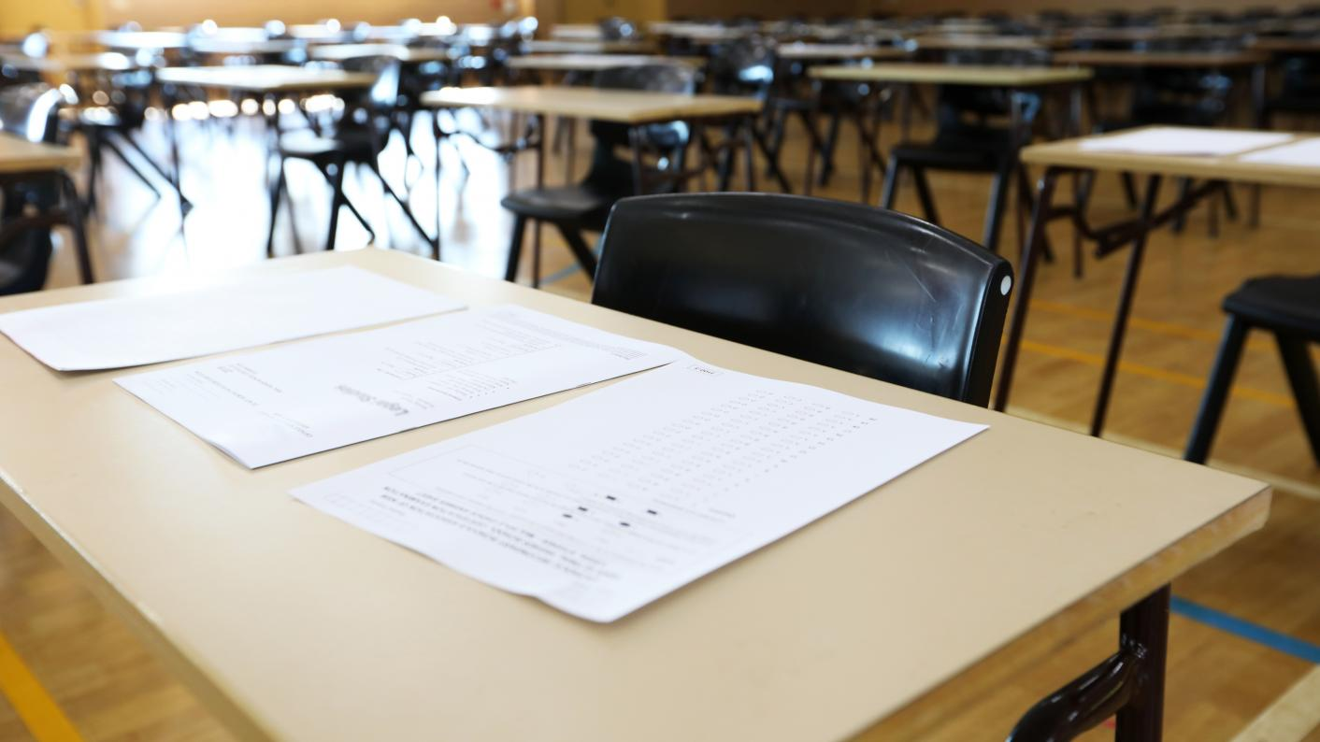

How do we help your child to be the best that they can be in their GCSE years?
High quality teaching and learning
Revision and intervention programmes
Mock Exams that ensure exam readiness
Revision strategies and support in Form Time/ Year Team Meetings
Revision resources available
Consistent communication with parents/carers
24 hour access to resources/lessons via Teams

Slide 4

Our Expectations of Students
Attendance is kept above 96% throughout the year
Year 10s attend all lessons on time and are ready to learn
They come to school prepared, with correct school uniform and equipment
Year 10s attend all intervention/revision sessions available to them
Year 10s complete homework and revision to a high standard
Students demonstrate positive behaviour for learning.

Slide 5

Everything on Teams!
All students should have their log in details and all communication should be through Teams.
Each subject teacher has their own teams page for students to be able to access revision, materials, resources and homework.
This is also a way that students and parents can communicate to teachers

Slide 6


Homework Expectations
All students vary in terms of how much time they should be spending on homework. Ideally they should be doing something everyday.
Roughly 30 mins-2 hours (depending) as they prepare for GCSEs.
Each subject will set homework depending on the department policy
There is a homework club that is run by our amazing learning support assistants (who are all subject specialists).
The library is also readily available for quiet study.

Slide 7
Parental access to homework on Teams:
All parents should be able to access their child’s homework via Teams
Every Sunday you will receive an email with an overview of your child’s homework for that week
All of student’s homework/due dates should be under the tab of ‘Assignments’.
A letter will be sent out next week with further information regarding Teams.

Slide 8

How do we support your child to be the best they can be?
Open-door-culture – Year 10 Office is always open!
Pastoral Year Coordinator focused on student support.
Support available through outside agencies
In school Counselling by a professional with over 20 years experience
SEN/EAL/DSP support available
Form Time activities in line with the new pastoral registration programme supporting students & their mental health.

Slide 9
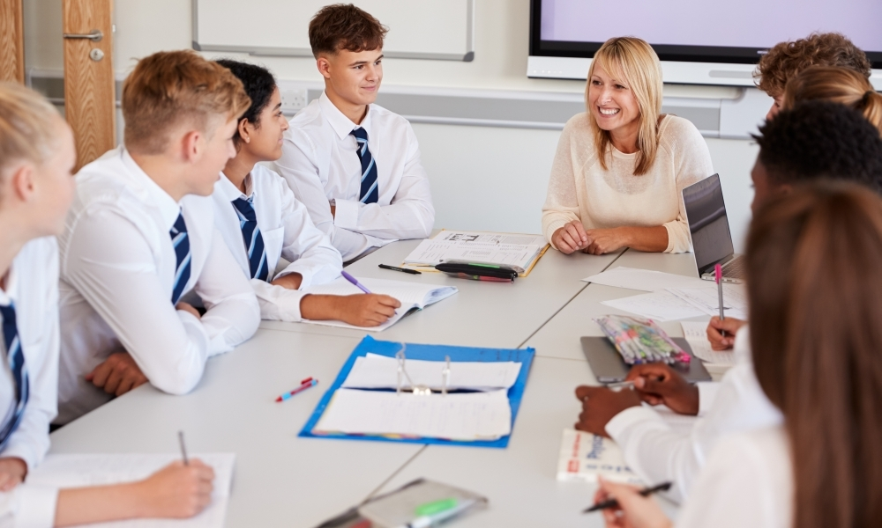
How do we support your child to be the best they can be?
Mentoring where appropriate.
PYC/DOL/SLT/Teaching staff/Tutor Team being present and alert for ways in which students might need support.
Access to library before, during (lunch times) and after school
Free breakfast club available from 7:45am-8:30am in the atrium

Slide 10
Trauma Informed School
St Augustine's is a trauma informed school.
This means that we understand that sometimes our students have more on their minds than school work.​
​
We aim to remain curious with our students, build positive relationships, so they all have a trusted adult that they can turn to for any support if they need to.​

Slide 11

How can you and your child ensure they are the best they can be?
How you can support your child
Encourage daily reading/revision at home
Ask them to explain what they are learning to you.
Encourage them to attend school and to be on time
Support with sanctions from home if they are not meeting expectations.
Together we can work as a team to ensure that your child gets the most of their time and experience here at St Augustine’s and truly is the best that they can possibly be!

Slide 12
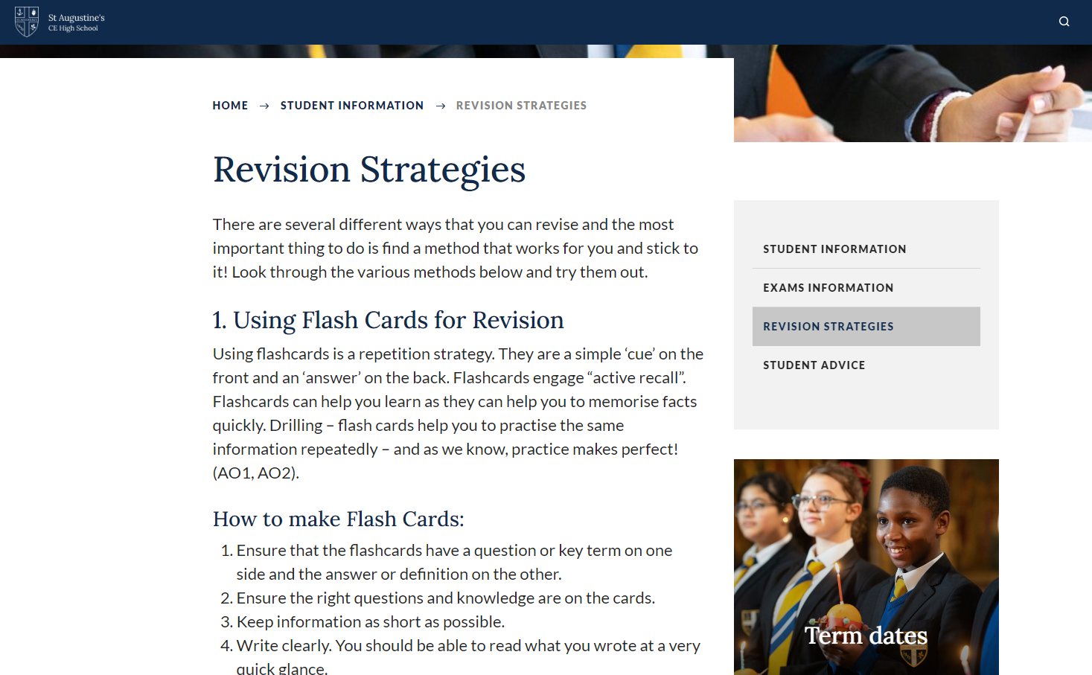
How can you and your child ensure they are the best they can be?

Slide 13
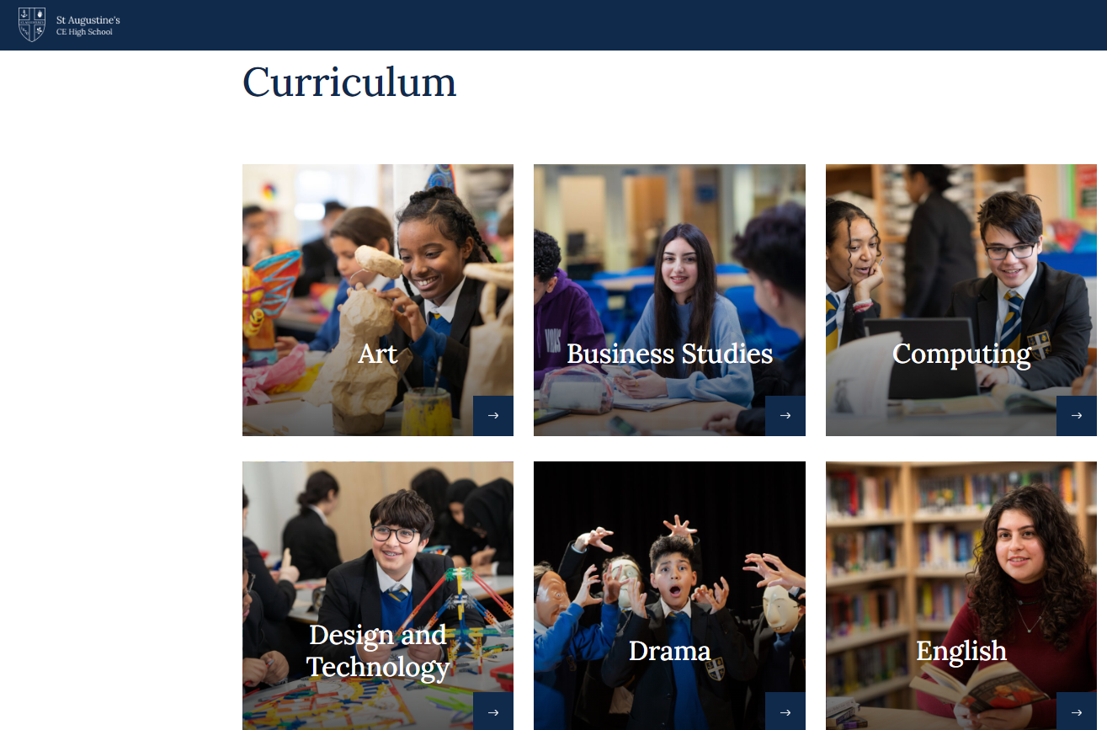
How can you and your child ensure they are the best they can be?

Slide 14
Exam boards by Subject
Subject | Exam Board
English | AQA
Maths | Edexcel
Science | AQA
Religious Studies | AQA
Geography | Edexcel B
History | Edexcel
Sociology | AQA
Psychology | AQA
PE | OCR
DT | AQA
Art | AQA
Business Studies | Edexcel
ICT | Edexcel
Graphics | OCR
Computer Science | OCR
Languages (French and Spanish) | Edexcel
Music | Edexcel
More information on the school website

Slide 15
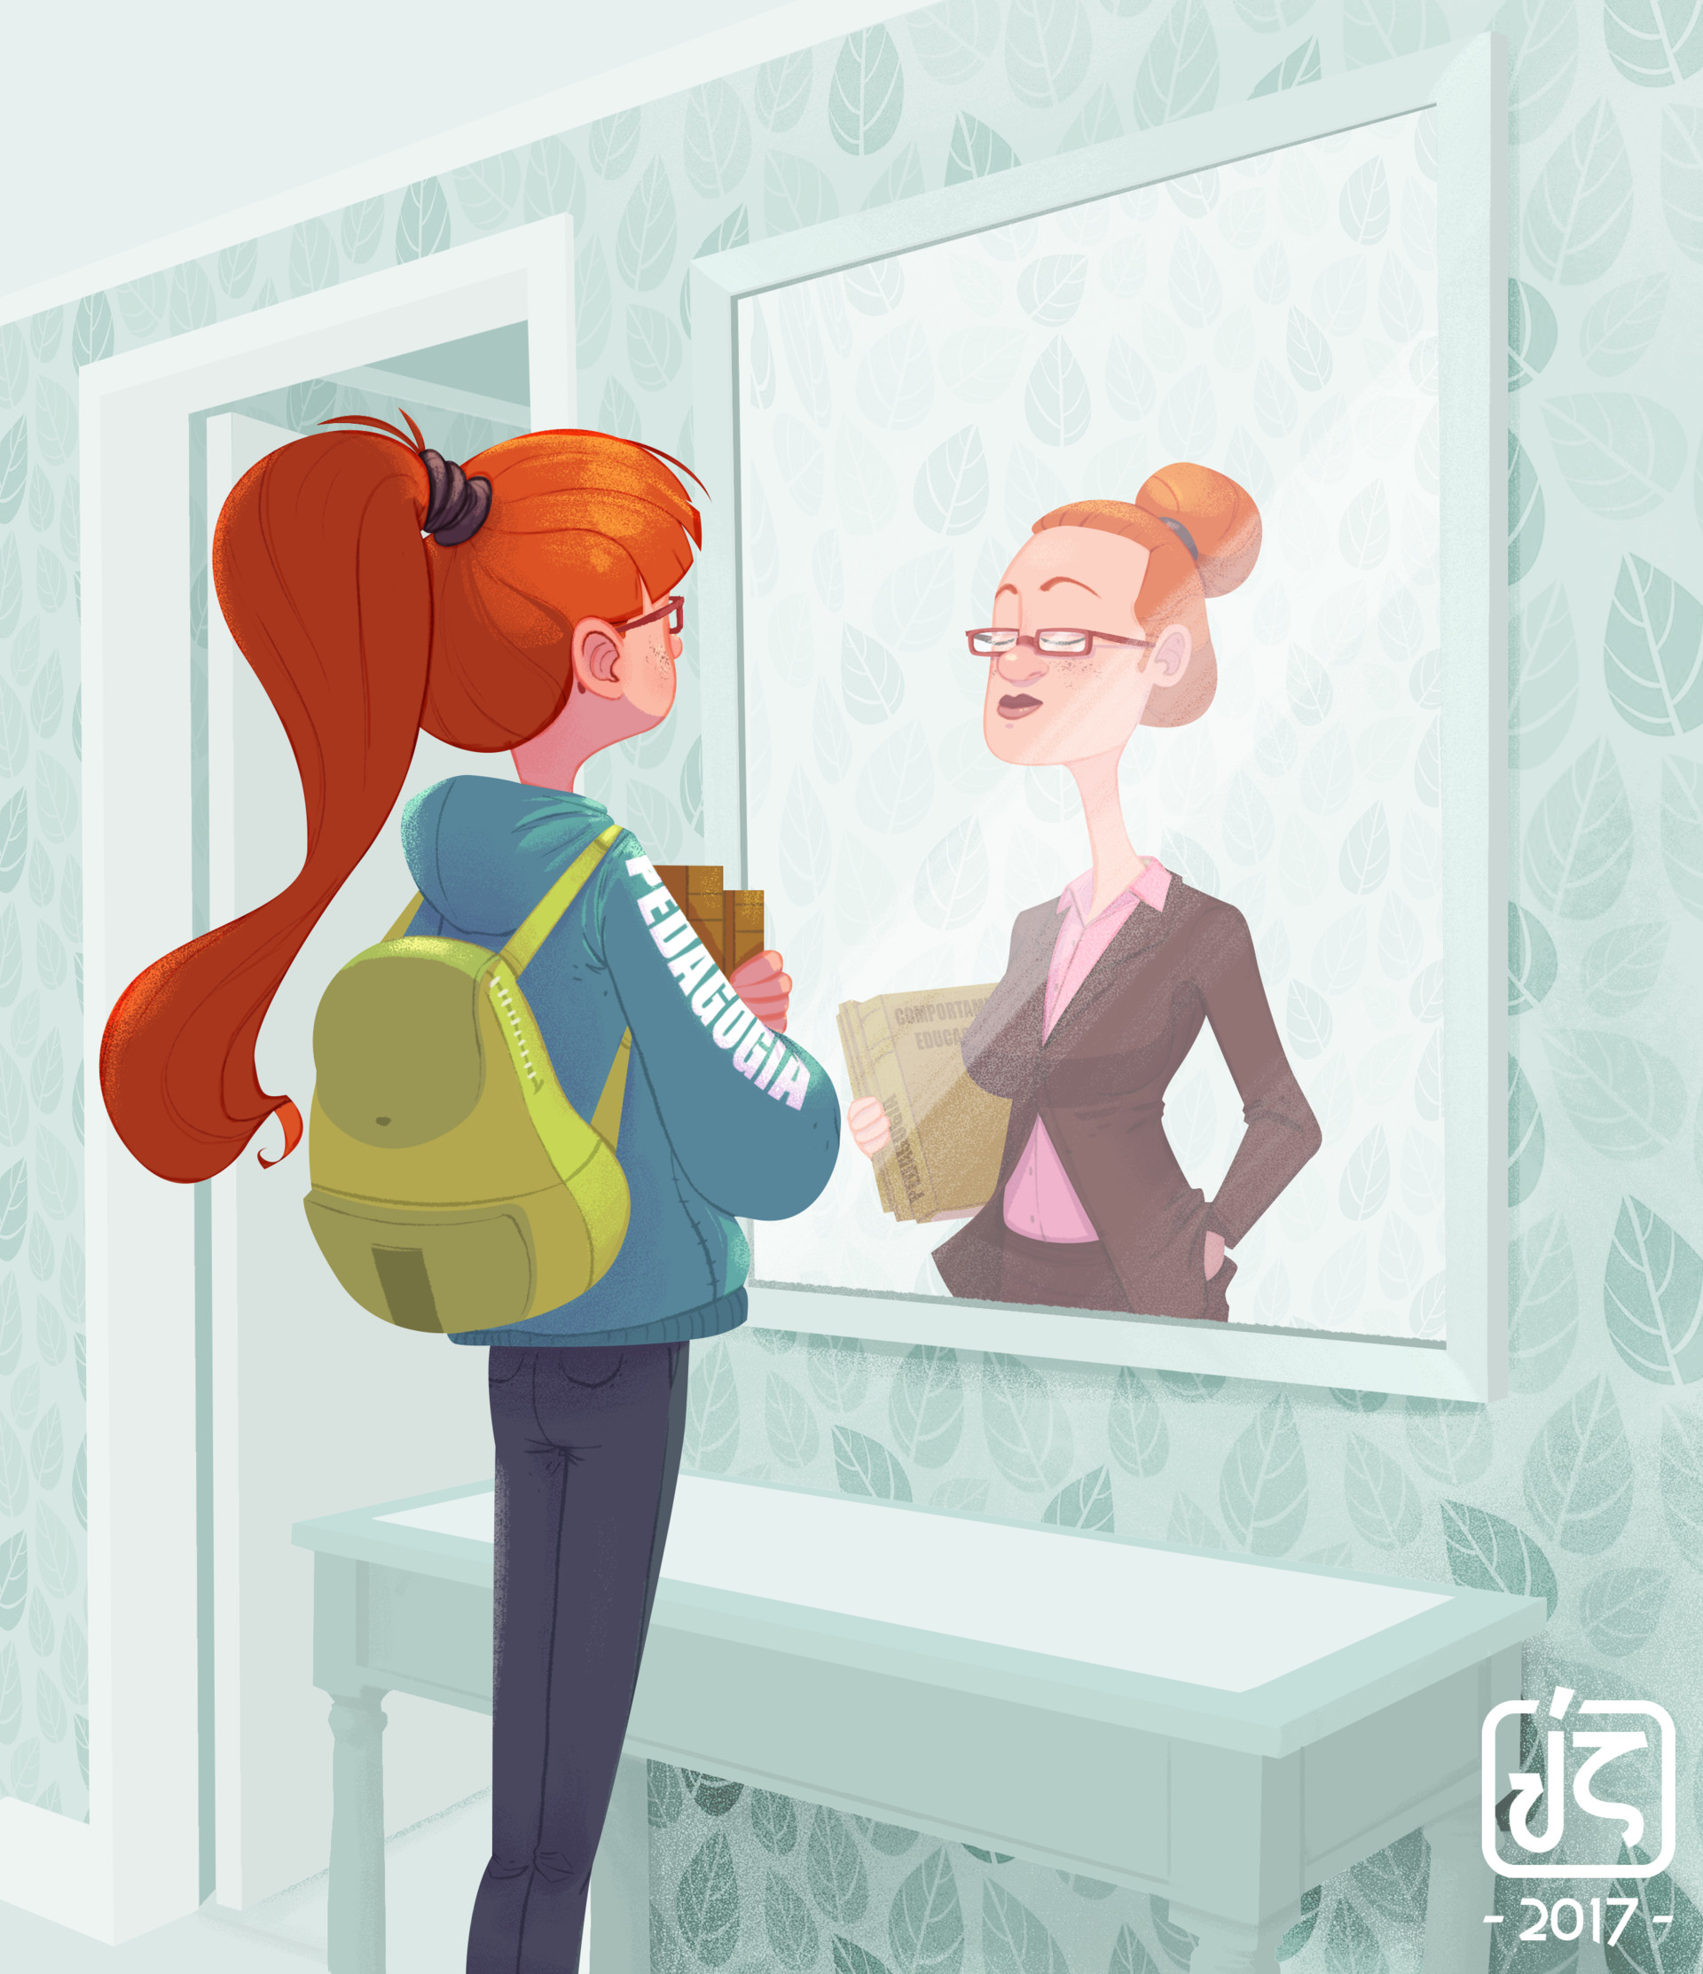
How do we inspire your child to think about their future?
Tutor time activities exploring post-16 pathways
Information about courses readily available at St Augustine’s from course leaders.
Careers guidance with specialist career staff/senior members of staff
Pathways to Success Seminars with KS4/5 team
Other work experience opportunities with business leaders
Workshops
Inspiring visitors giving presentations
St Augustine’s 6th Form Open Evening in year 11

Slide 16
The Pastoral Programme Registration Timetable
This is the pastoral programme that is followed everyday, registration is a normal lesson part of student’s timetables.
Year Group | Session | Monday | Tuesday | Wednesday | Thursday | Friday
10 | AM Registration & Reediness: 8.50- 9:10 | Theme of the Week and Collective Worship Follow-up | Literacy, Oracy, Numeracy | Topical Talk | Physical Social and Health Education | Collective Worship 8:50 Hall
 | PM Registration & Reflection: 15:10 -15:30 | Citizenship and Culture | Wellbeing and Self-Regulation | Year Group Assembly 3:10 pm Hall/ Work Related Learning | Student Voice | T

Slide 17
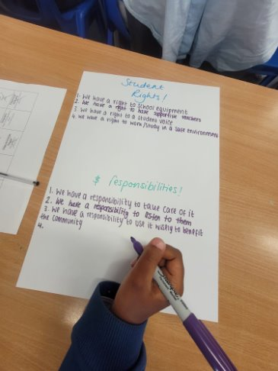
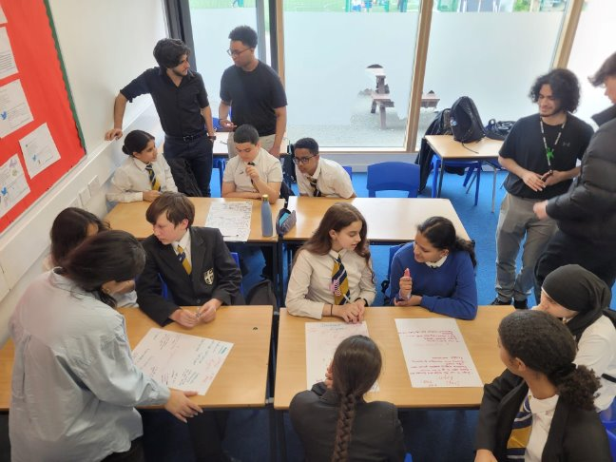
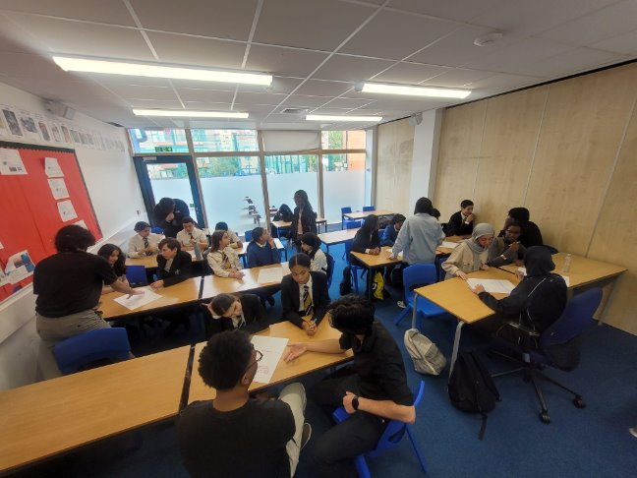
Student Leadership Opportunities: What is Student Voice?
Skills students will develop:​
​
Leadership skills​
Organisational skills​
Empathy​
Active listening​
Confidence​
Presentation skills (speaking)
Have your say!​
Make a difference!​
Share ideas!​
Work as a Team to improve the community!​
Fundraise for lots of charities – near & far!​
Protect the Environment​
Promote positive physical & mental health​
Look after our school

Slide 18

Year 10 - Key Dates
June 2025​
Year 10 Mock Exams
GCSE Geography Field Trips
7th November- River Fieldwork
Parents Evening #1 Thursday 28th November 2024
Parents Evening #2 in June 2025
Year 10 Employability Skills opportunities throughout the year
Celebration of all cultures and Black History Month- October 2024
School Trips
23rd September
Year 10 new school pictures
Possible Residential Trip
Reports and Data Collections in December and March
11th September
Year 10 parents expectations evening

Slide 19
Year 10 Pictures, Say Cheese!
Monday 23rd September
Students will be having their new school photographs taken on Monday 23rd September.
They must have their full school uniform: Shirt tucked in, tie done up blazer on with school badge
If they do not have their full school uniform they will be given something from lost property to wear for their photo instead

Slide 20
Work Related Learning
As most things in our society, covid has had a substantial effect on the way that work experience is now run.
Year 10 will now gain experience of the world of work though the expertise of our careers officer throughout the year. This will be done through many work related opportunities:
Workshops
Trips
Visitors to school
Online events
As mentioned previously, as part of the new pastoral registration programme, every other Wednesday they will be focusing on work related learning.

Slide 21
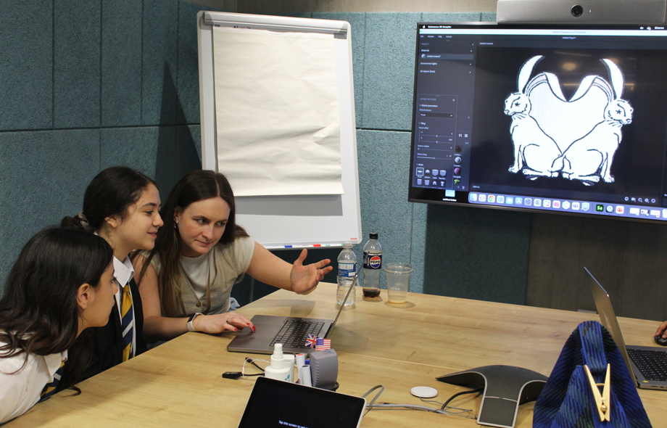
Employability Skills Week:
Objectives
Students gain knowledge of different sectors and range of job roles
Students develop professional attributes (how to present themselves, communicate in an appropriate way etc)
Students develop a knowledge of the world of work and associated expectations
Students gain knowledge of how transferable skills relate to jobs and careers
Students gain knowledge of routes into different career paths - .e.g apprenticeship, college, training, university
Students develop and demonstrate transferable skills - .e.g communication, teamwork
Student gain knowledge of how transferable skill relate to jobs and careers

Slide 22

Parent Pay
Anything to do with financial matters has to go through Parent Pay. Hopefully you would have had your child’s account set up already.
This is the payment system used here at the school for everything to do with:
School Meals
Trips
Books/Resources
Purchasing uniform
etc

Slide 23

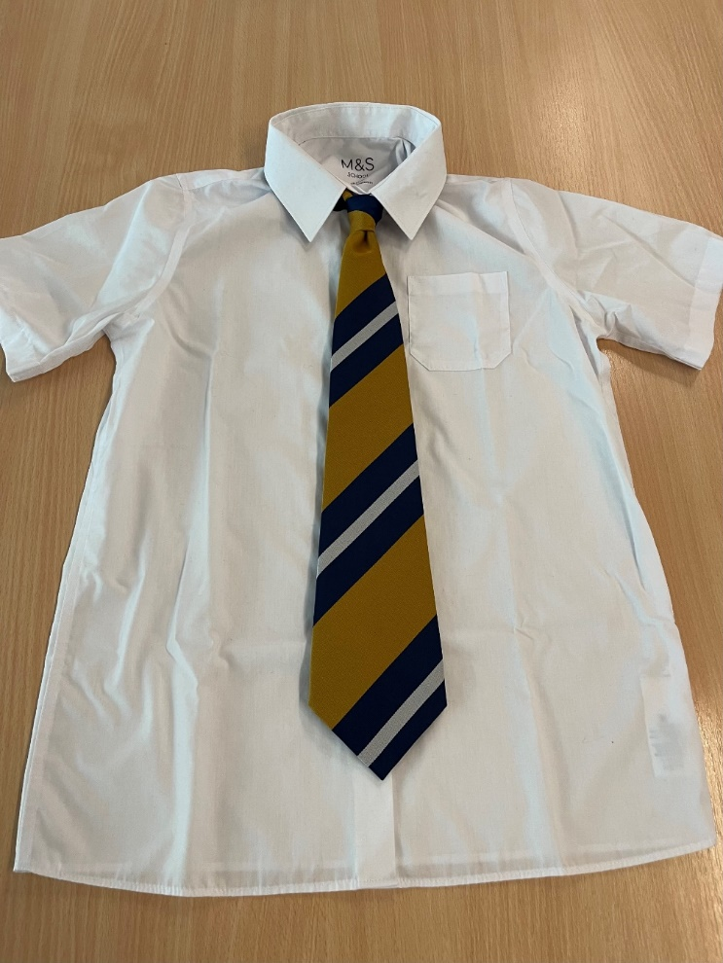


Year 10 Student Uniform Expectations-
Al students must wear a white shirt tucked in, a blazer with the school badge and a tie.
If students misplace either of these, they will then have to pay for a replacement through Parent pay and collect from reception.
Students must wear their blazers to school, it is a compulsory part of the school uniform.

Slide 24
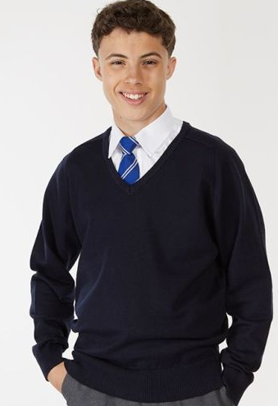
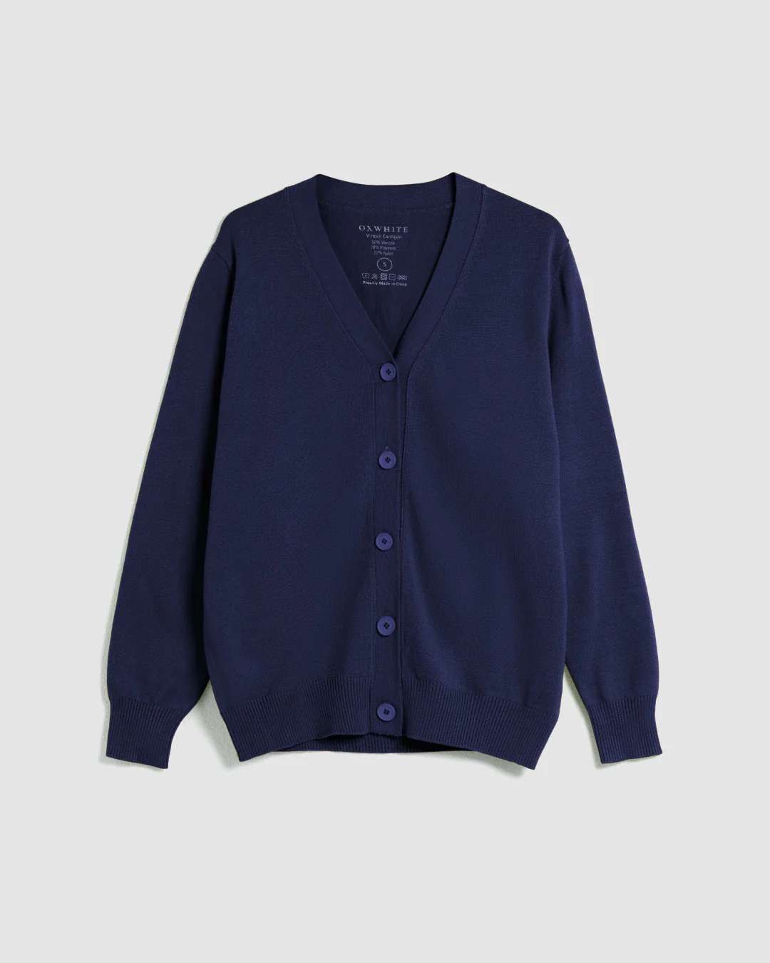
Navy blue school jumpers are optional
Side note:
The blue PE school jumpers are not correct school uniform
Navy blue V-neck jumpers or V-neck cardigans with buttons are now allowed as part of the school uniform.
They must be plain with no logos, badges, no collars, embellishments or patterns.

Slide 25

Year 10 Student Expectations-
PUNCTUALITY:
Students should be on the school site by 8:40am each morning.
This is because Collective Worship and AM registration begins at 8:50am. This is much later than most other schools, therefore our school community expects that all students are in full uniform and on time each and every morning.
Concerns:
If there are students who are regularly late, Ms Alexander and I will be monitoring this but will be in contact with parents/carers if need be.

Slide 26

Year 10 Student Expectations-
ATTENDANCE:
As we are all already aware of the significant impact that low attendance can have on student’s progress and outcomes, we will be highly emphasising the importance of their attendance. Especially as they are now entering their GCSE year.
Attendance must be high, consistent and above 96%.
Concerns:
If there are students who are regularly absent, Ms Alexander and I will be monitoring this but will be in contact with parents/carers if need be.

Slide 27



Year 10 Student Expectations-
SOCIAL MEDIA:
We support all parent/carers who ensure that their child uses social media safely, legally and respectfully outside of school hours.
Should it be brought to the attention of the school that a student (or adult) has used any form of social media to bully, humiliate, intimidate, threaten, discriminate against, harass another member of our school community. Or has encouraged others to do so. Then the school will investigate this and, if appropriate, will pass the findings of the investigation to the police for further action.
This includes creating fake social media accounts purporting to be from the victim, baiting accounts designed to encourage large followings, uploading any image, recording or video of a member of our school community without their permission.

Slide 28
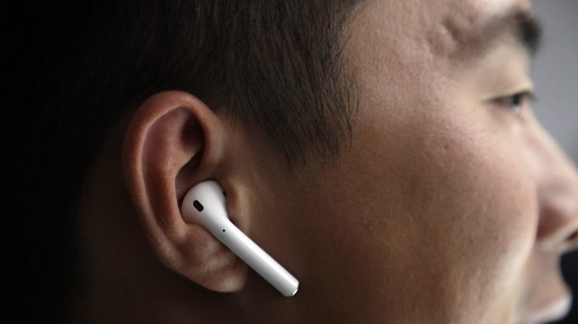
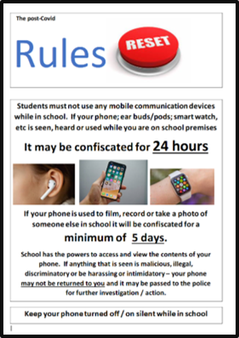
Year 10 Student Expectations-
MOBILE DEVICES & EARBUDS/AIRPODS:
The school's mobile device policy (Phones and Smart Watches) is reasonable and clear. Students may bring a mobile device to school but it must not be used, be seen or be heard on any part of the school premises. Should a student breach this expectation the device is confiscated for 24hrs and must be collected by a parent/carer.
Equally any student wearing earbuds (air pods etc.) on the school site will have them confiscated along with the attached/paired mobile for the usual 24hr period.
If any device has been used to film, record or take an image of any member of our school community (or been used maliciously) it will be confiscated for 5 schools days whilst an investigation is carried out. This will also involve the school exercising its right to examine the contents of the device. Should any content, found on the device, be malicious; illegal; discriminatory; or be harassing or intimidatory in nature. Then the school will pass the device to the police for further action.

Slide 29





Year 10 Student Expectations-
If a student is seen with an energy drink, it will be confiscated and thrown away. Mr Moriarty has already communicated to students and parents/carers that they are not to be bought to school previously.

Slide 30
Exams 2026!
We as a team have such high expectations for this amazing year group. We really hope that in 2026, we can show you such positive images such as the ones
below of students who are elated and joyful and most of all proud of all that they have achieved. Together we can make this happen!
For any additional information please see our school website
Useful contacts for year 10
Main office: mail@stahigh.org Telephone: 020 7328 3434
Headteacher: Ms Kelly rkelly@stahigh.org
Director of Learning: Ms Hill shill@stahigh.org
Pastoral Coordinator: Ms Alexander lalexander@stahigh.org (Ext: 253)

